Slide 1


Hoodie
Music
Downloader
Mobile Application and Cloud Computing 2019/2020

Slide 2

-[
Describing our Team
]-
Our Team
Luca Tomei 1759275
Danilo Marzilli 1878501
Giovanni Trinca 1542534

Slide 3
Introduction
Structure
OUTLINE
OF
TALK
Design
Look and Feel
Conclusion
Future Works

Slide 4
The app is designed to easily download and listen to songs. No matter if you are with or without internet connection: this is the right choice for you.
Hoodie is the best way to listen to music!
Search and stream any song without paying a subscription
Download songs you love for quick access later
Create unlimited library, reorder and manage your music
Listen music in portrait and horizontal mode
MAIN
FEATURES
You can also listen to trending music by genre by selecting one of our favorite charts. Charts is a new, easy way to stay plugged in to what’s trending in the world of sound. With unique lists for all the genres, this feature is your destination for the latest and greatest out there.
Introduction.

Slide 5
-[
AN AGILE PROCESS
]-
Our Approach
In order to develop the application correctly we decided to use a SCRUM approach, proceeding by sprints.
Each of us developed some small functionalities coming from the user stories realized at the beginning. The sprint was about 2 weeks.
Introduction.

Slide 6



Used Technologies
Backend
Frontend
Node.js
Asynchronous event-driven Javascript runtime.
We use Node.js to download songs directly from Deezer.
Firebase
Backend as a Service
(Baas).
We store our users, their searches, all the stuff needed by our app.
Swift
Powerful and intuitive programming language for macOS, iOS, watchOS and tvOS that support both object-oriented and functional programming.
Structure.

Slide 7


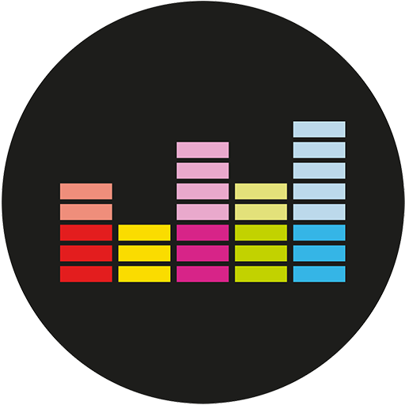
Application Architecture
Mobile Application
Raspberry Pi
Deezer Api
Here is where our backend lies, it handles users and their permissions, together with music download.
Deezer Simple API provides a nice set of services to build up applications allowing the discovery of music catalogue.
The mobile application developed in Swift allows communicationwith the server.
Structure.

Slide 8





Backend Structure
Firebase Login
Google Signin
Facebook API
Firebase Realtime Database
Raspberry Pi
We have managed the authentication features with Firebase Authentication, Google OAuth 2 and Facebook API.
Raspberry hosts our server. Through the "express" framework, with the listen method, the application listens on port 8080.
This is used to carry on some important data of the user to provide a better UX.
Structure.

Slide 9
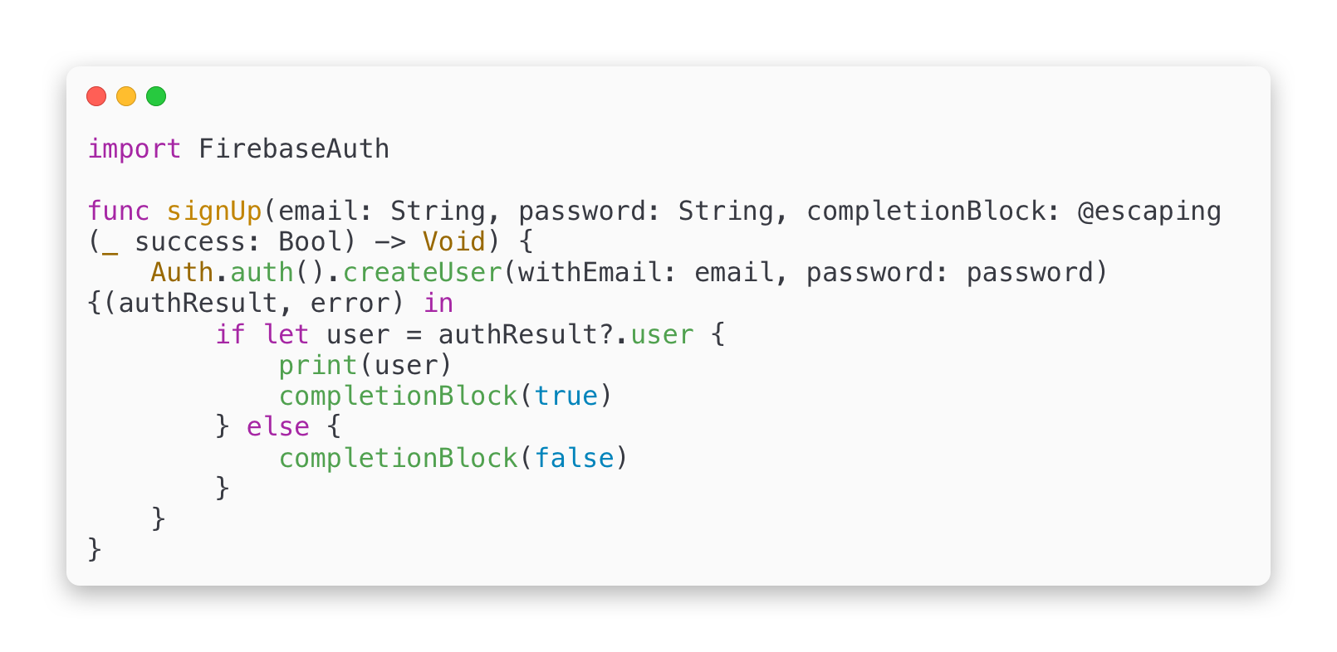
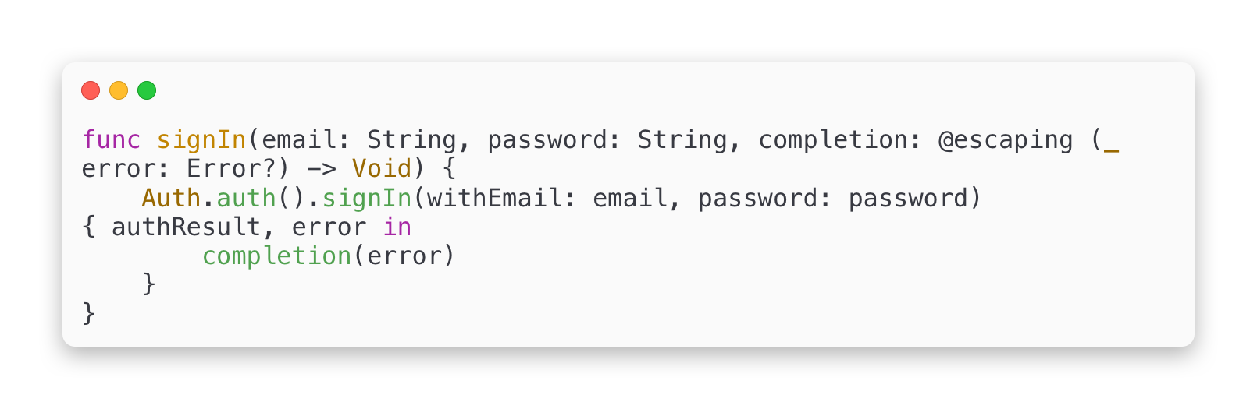
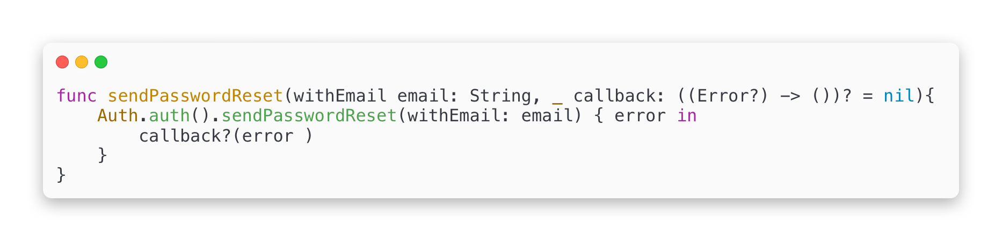
FIREBASE AUTHENTICATION
We use Firebase Authentication to allow users to log into our app using their personal email and password.
These credentials will be passed to the Firebase Authentication SDK and after getting a response from their servers, the user's data will be saved to Firebase Realtime Database.
Structure.

Slide 10
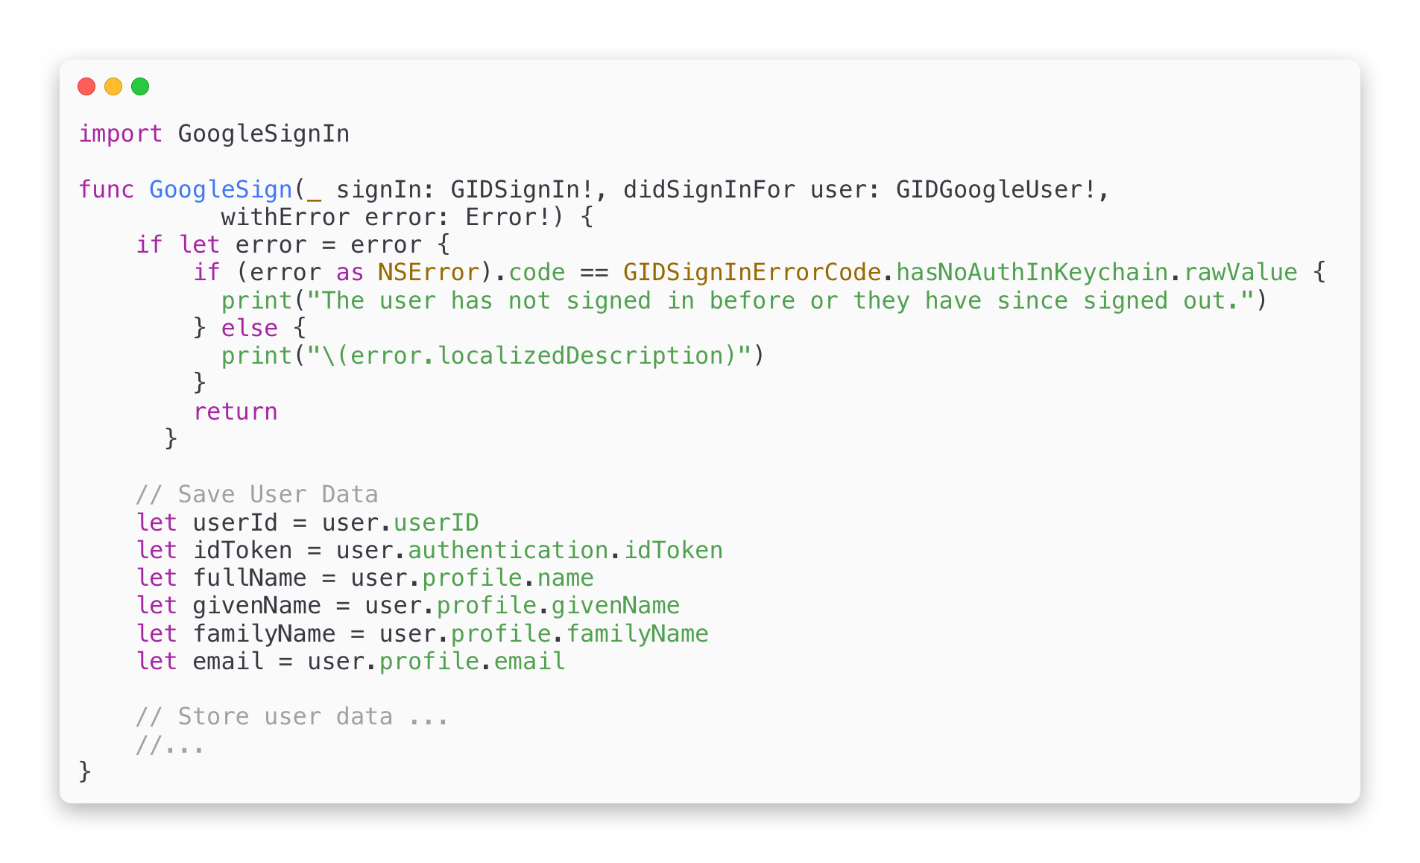
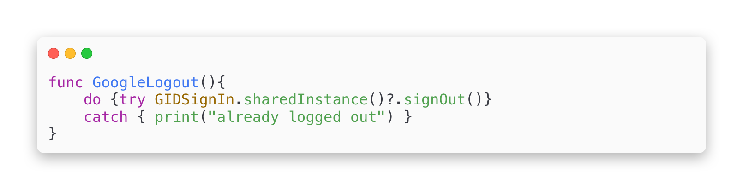
GOOGLE AUTHENTICATION
Google Sign-In manages the OAuth 2.0 flow and token lifecycle, simplifying our integration with Google APIs.
OAuth 2.0 works with the following four actors:
authorization server: responsible for authentication and authorization.
resource server: in charge of serving up resources if a valid token is provided.
resource owner: the owner of the data, that is, the end user of Hoodie.
client: the Hoodie mobile app
Structure.

Slide 11
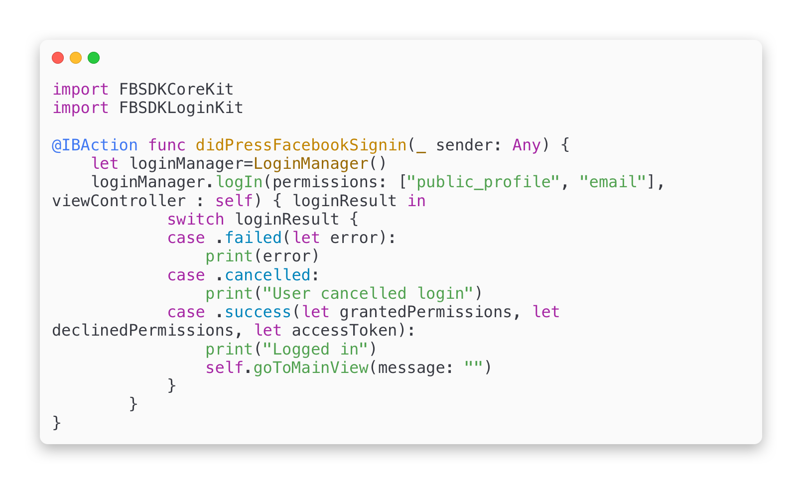
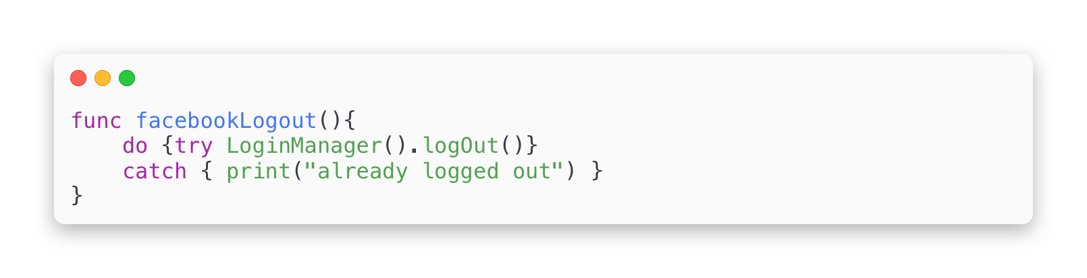
FACEBOOK AUTHENTICATION
With the rise of social media, Facebook login integration has become one of the must have features in mobile apps. Despite the fact that every developer is integrating Facebook login into their apps, Facebook is doing a very poor job on updating their documentations.
Using the Facebook authentication token we get from Swift, we can access the Facebook API and get the user’s name and email to create an account.
Structure.

Slide 12

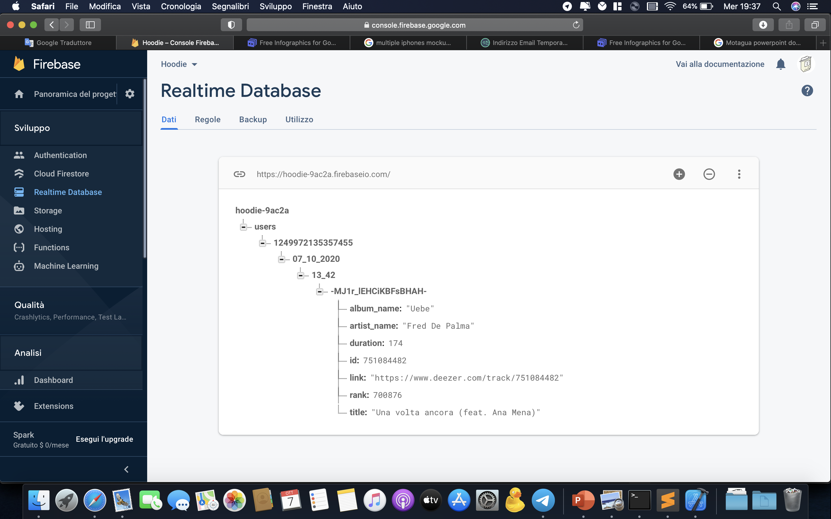
REALTIME DATABASE
The Firebase Realtime Database is a NoSQL cloud-hosted database. Data is stored as JSON and synchronized in real time to every connected client.
All of our clients share one Realtime Database instance and automatically receive updates with the newest data.
Structure.

Slide 13
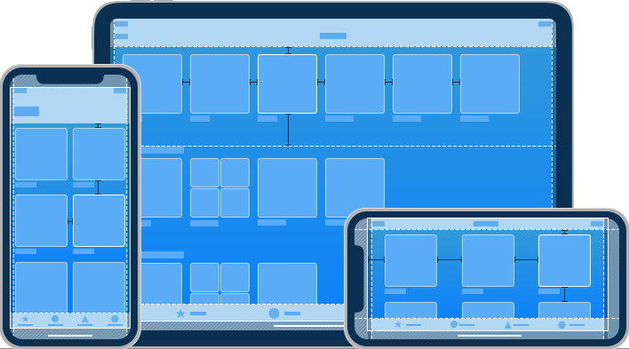



Multi-Platform iOS Design
iOS
Application
Responsive Layout
Multithreading
DispatchQueue + URLSession for https requests on separated thread
(Codable protocol used to convert JSON to native Swift struct)
Model View ViewModel Pattern Design
Design.

Slide 14
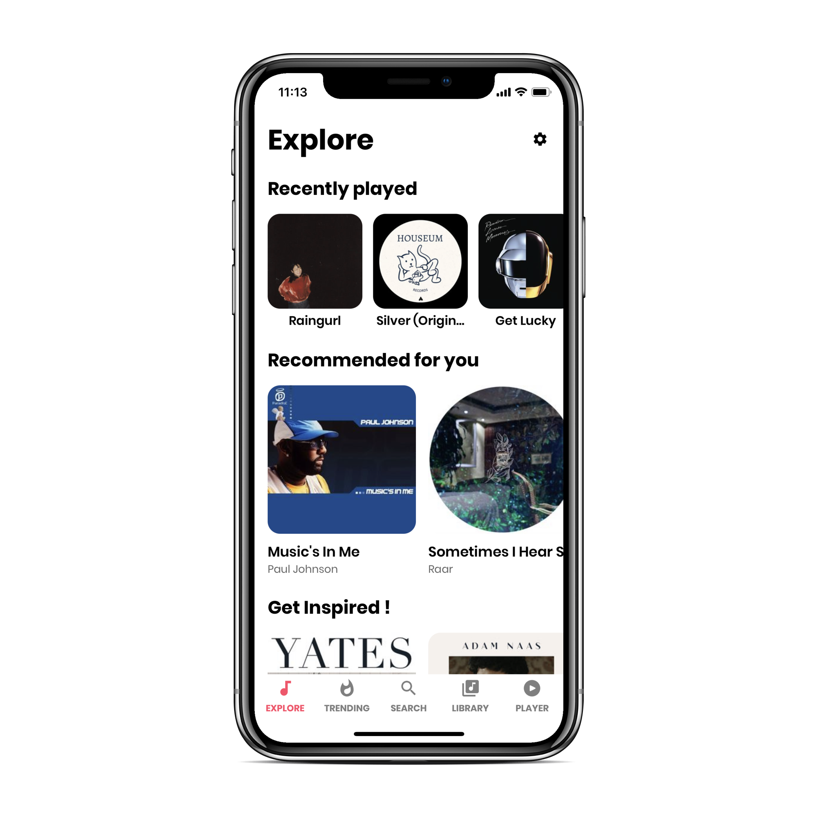
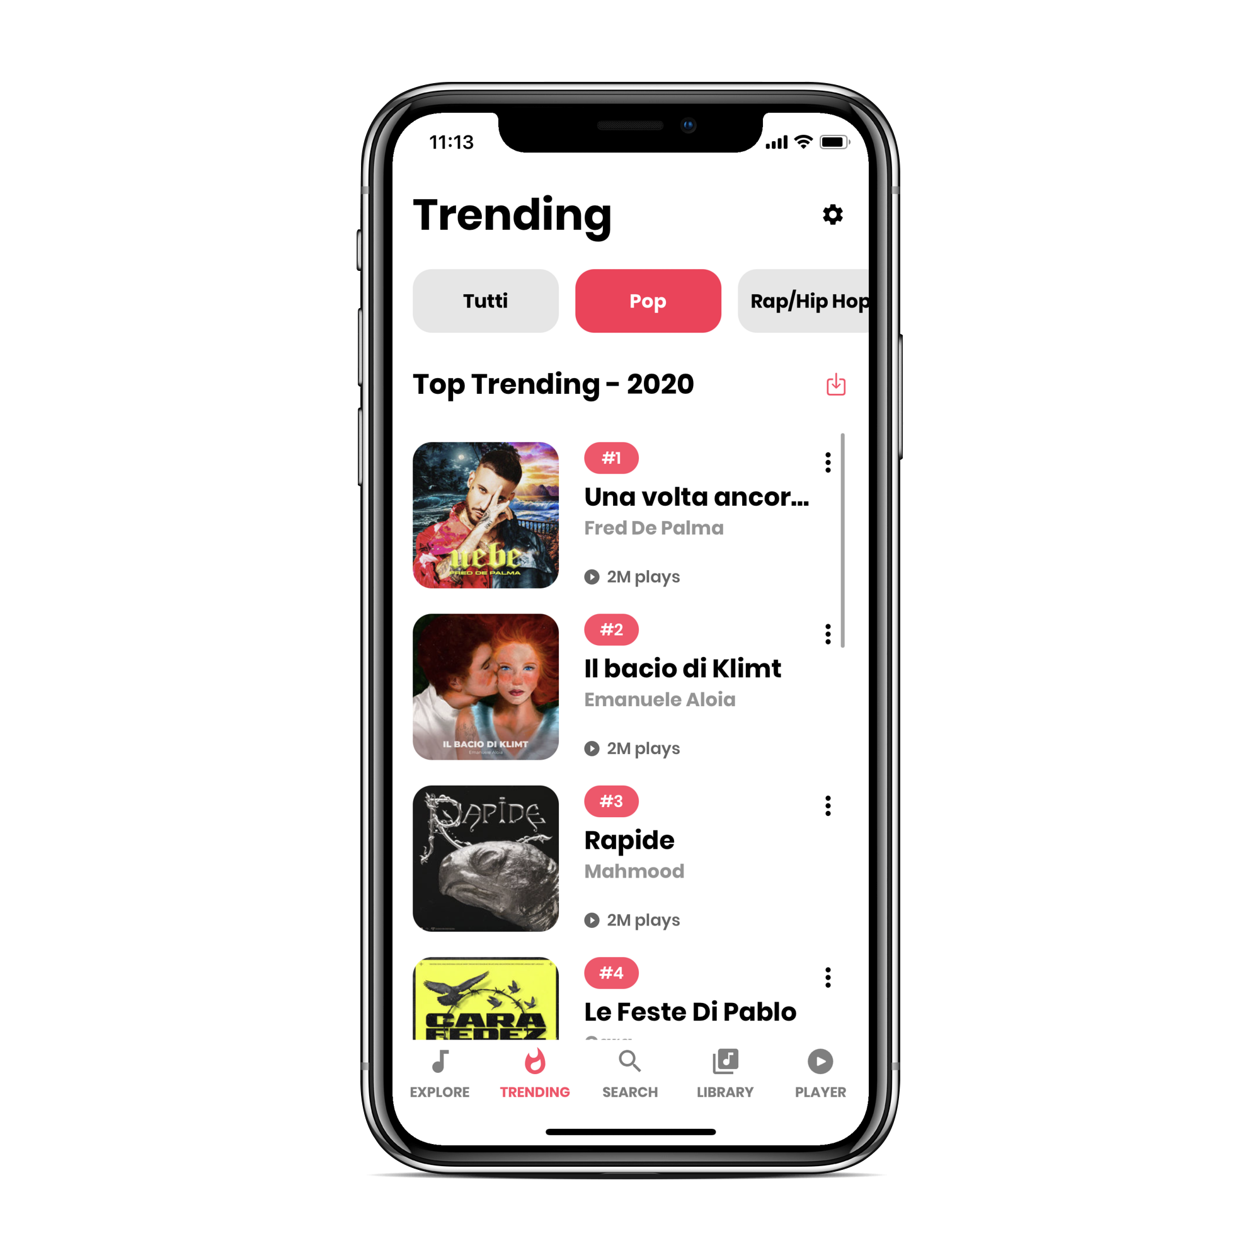
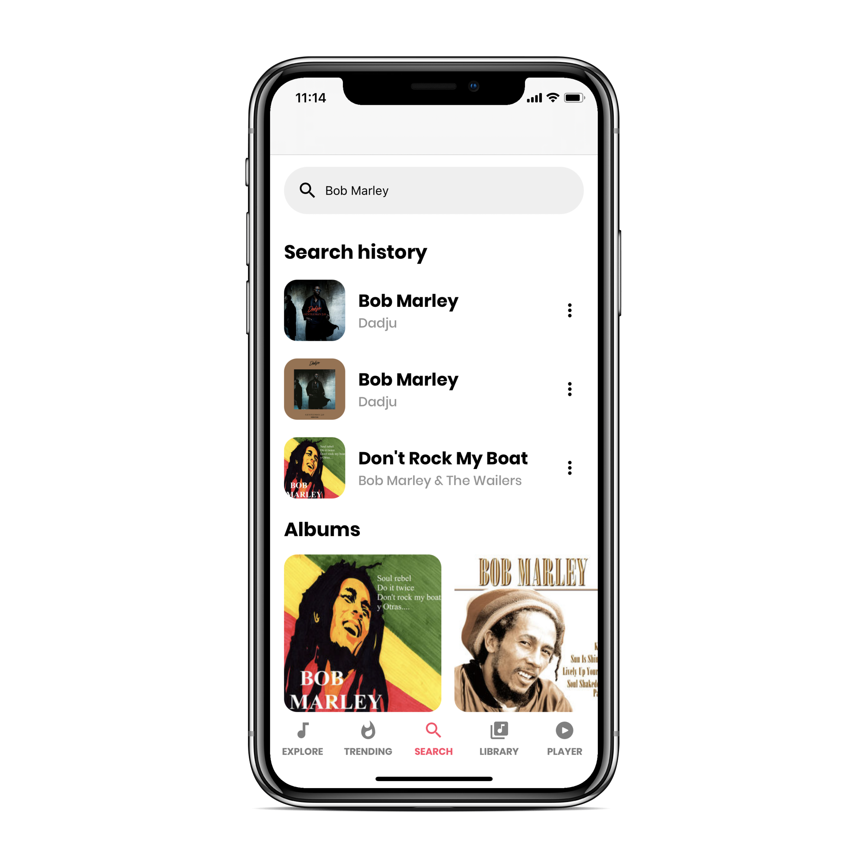
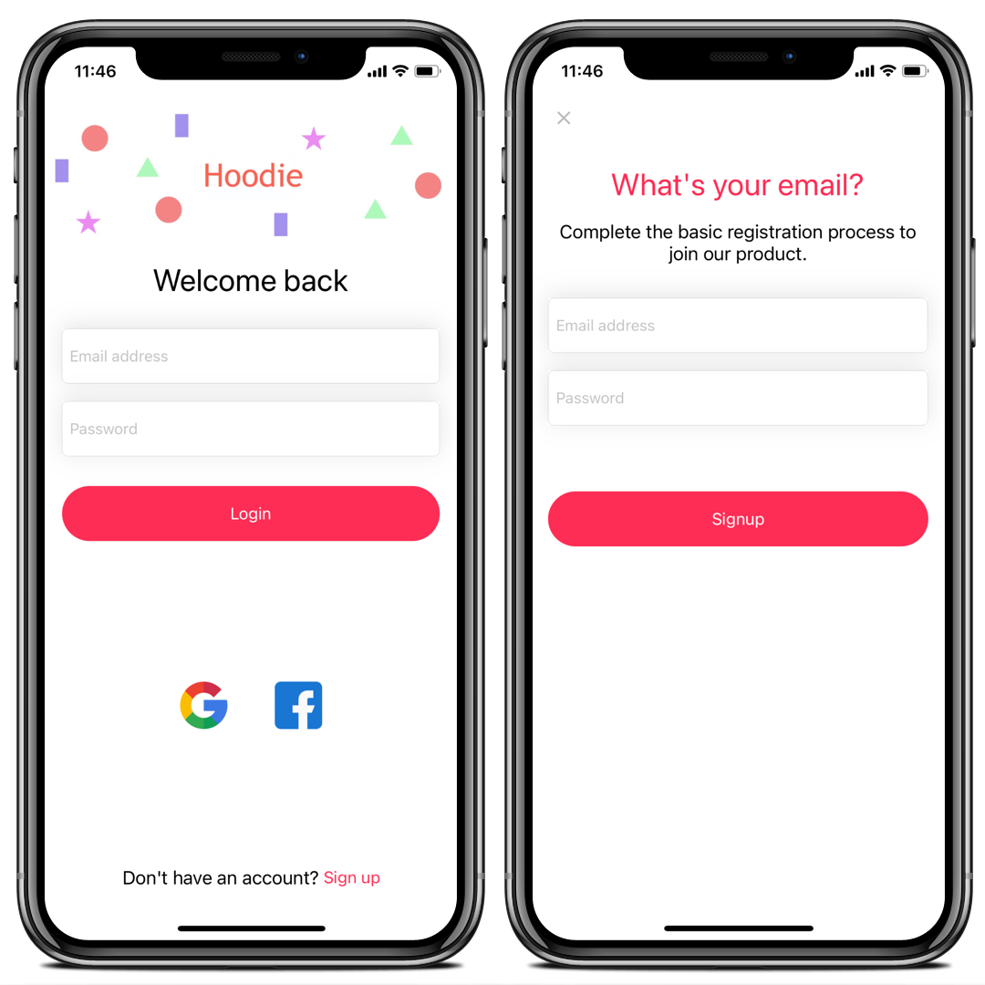
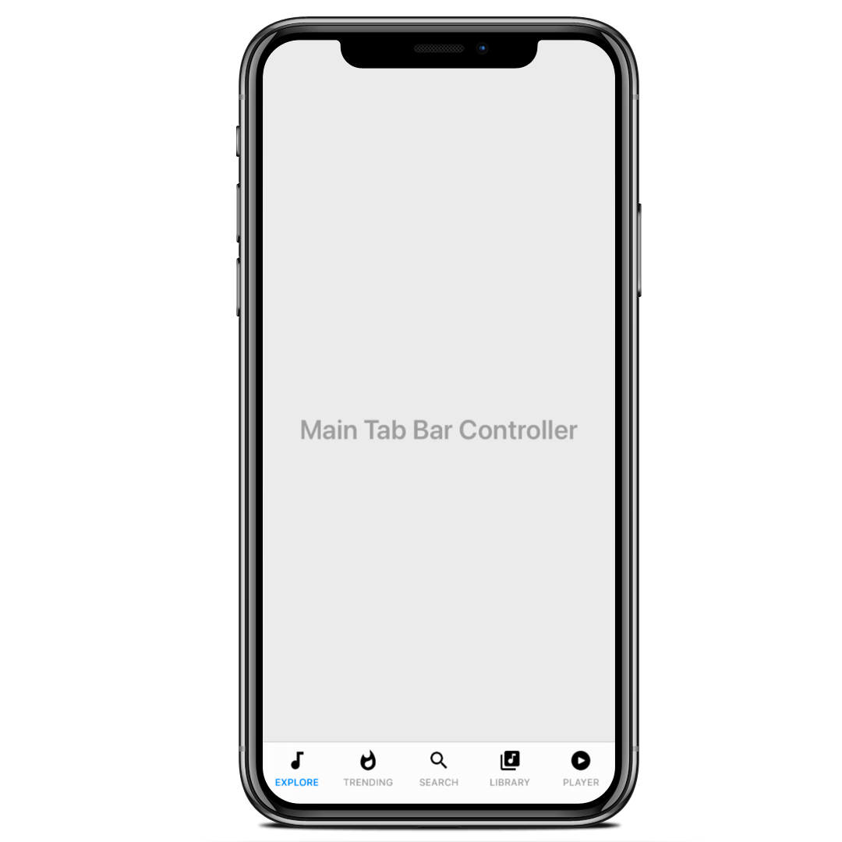
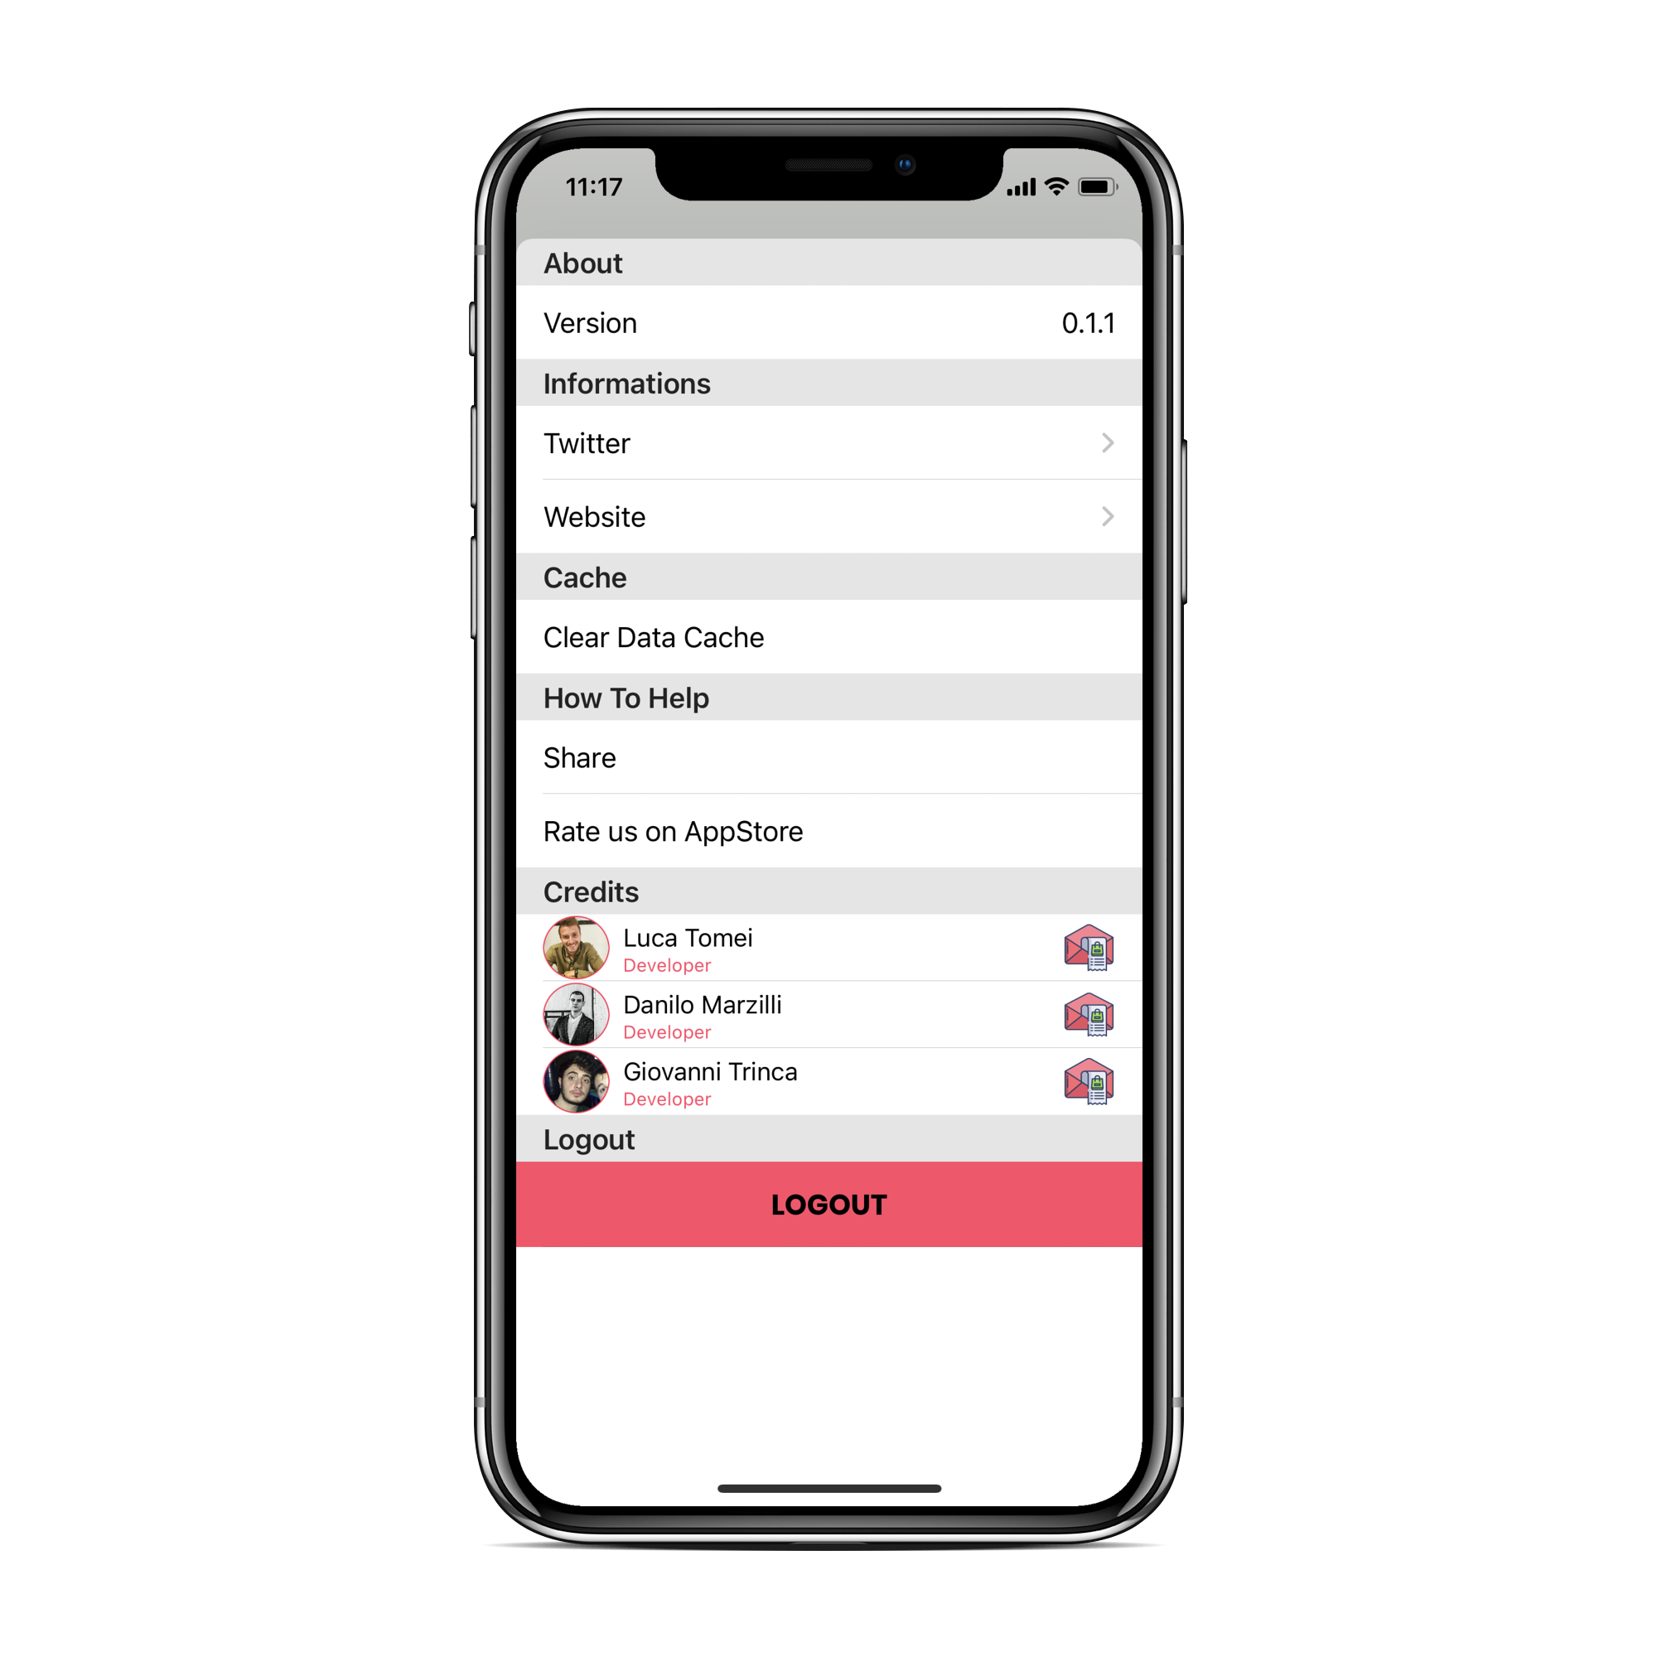
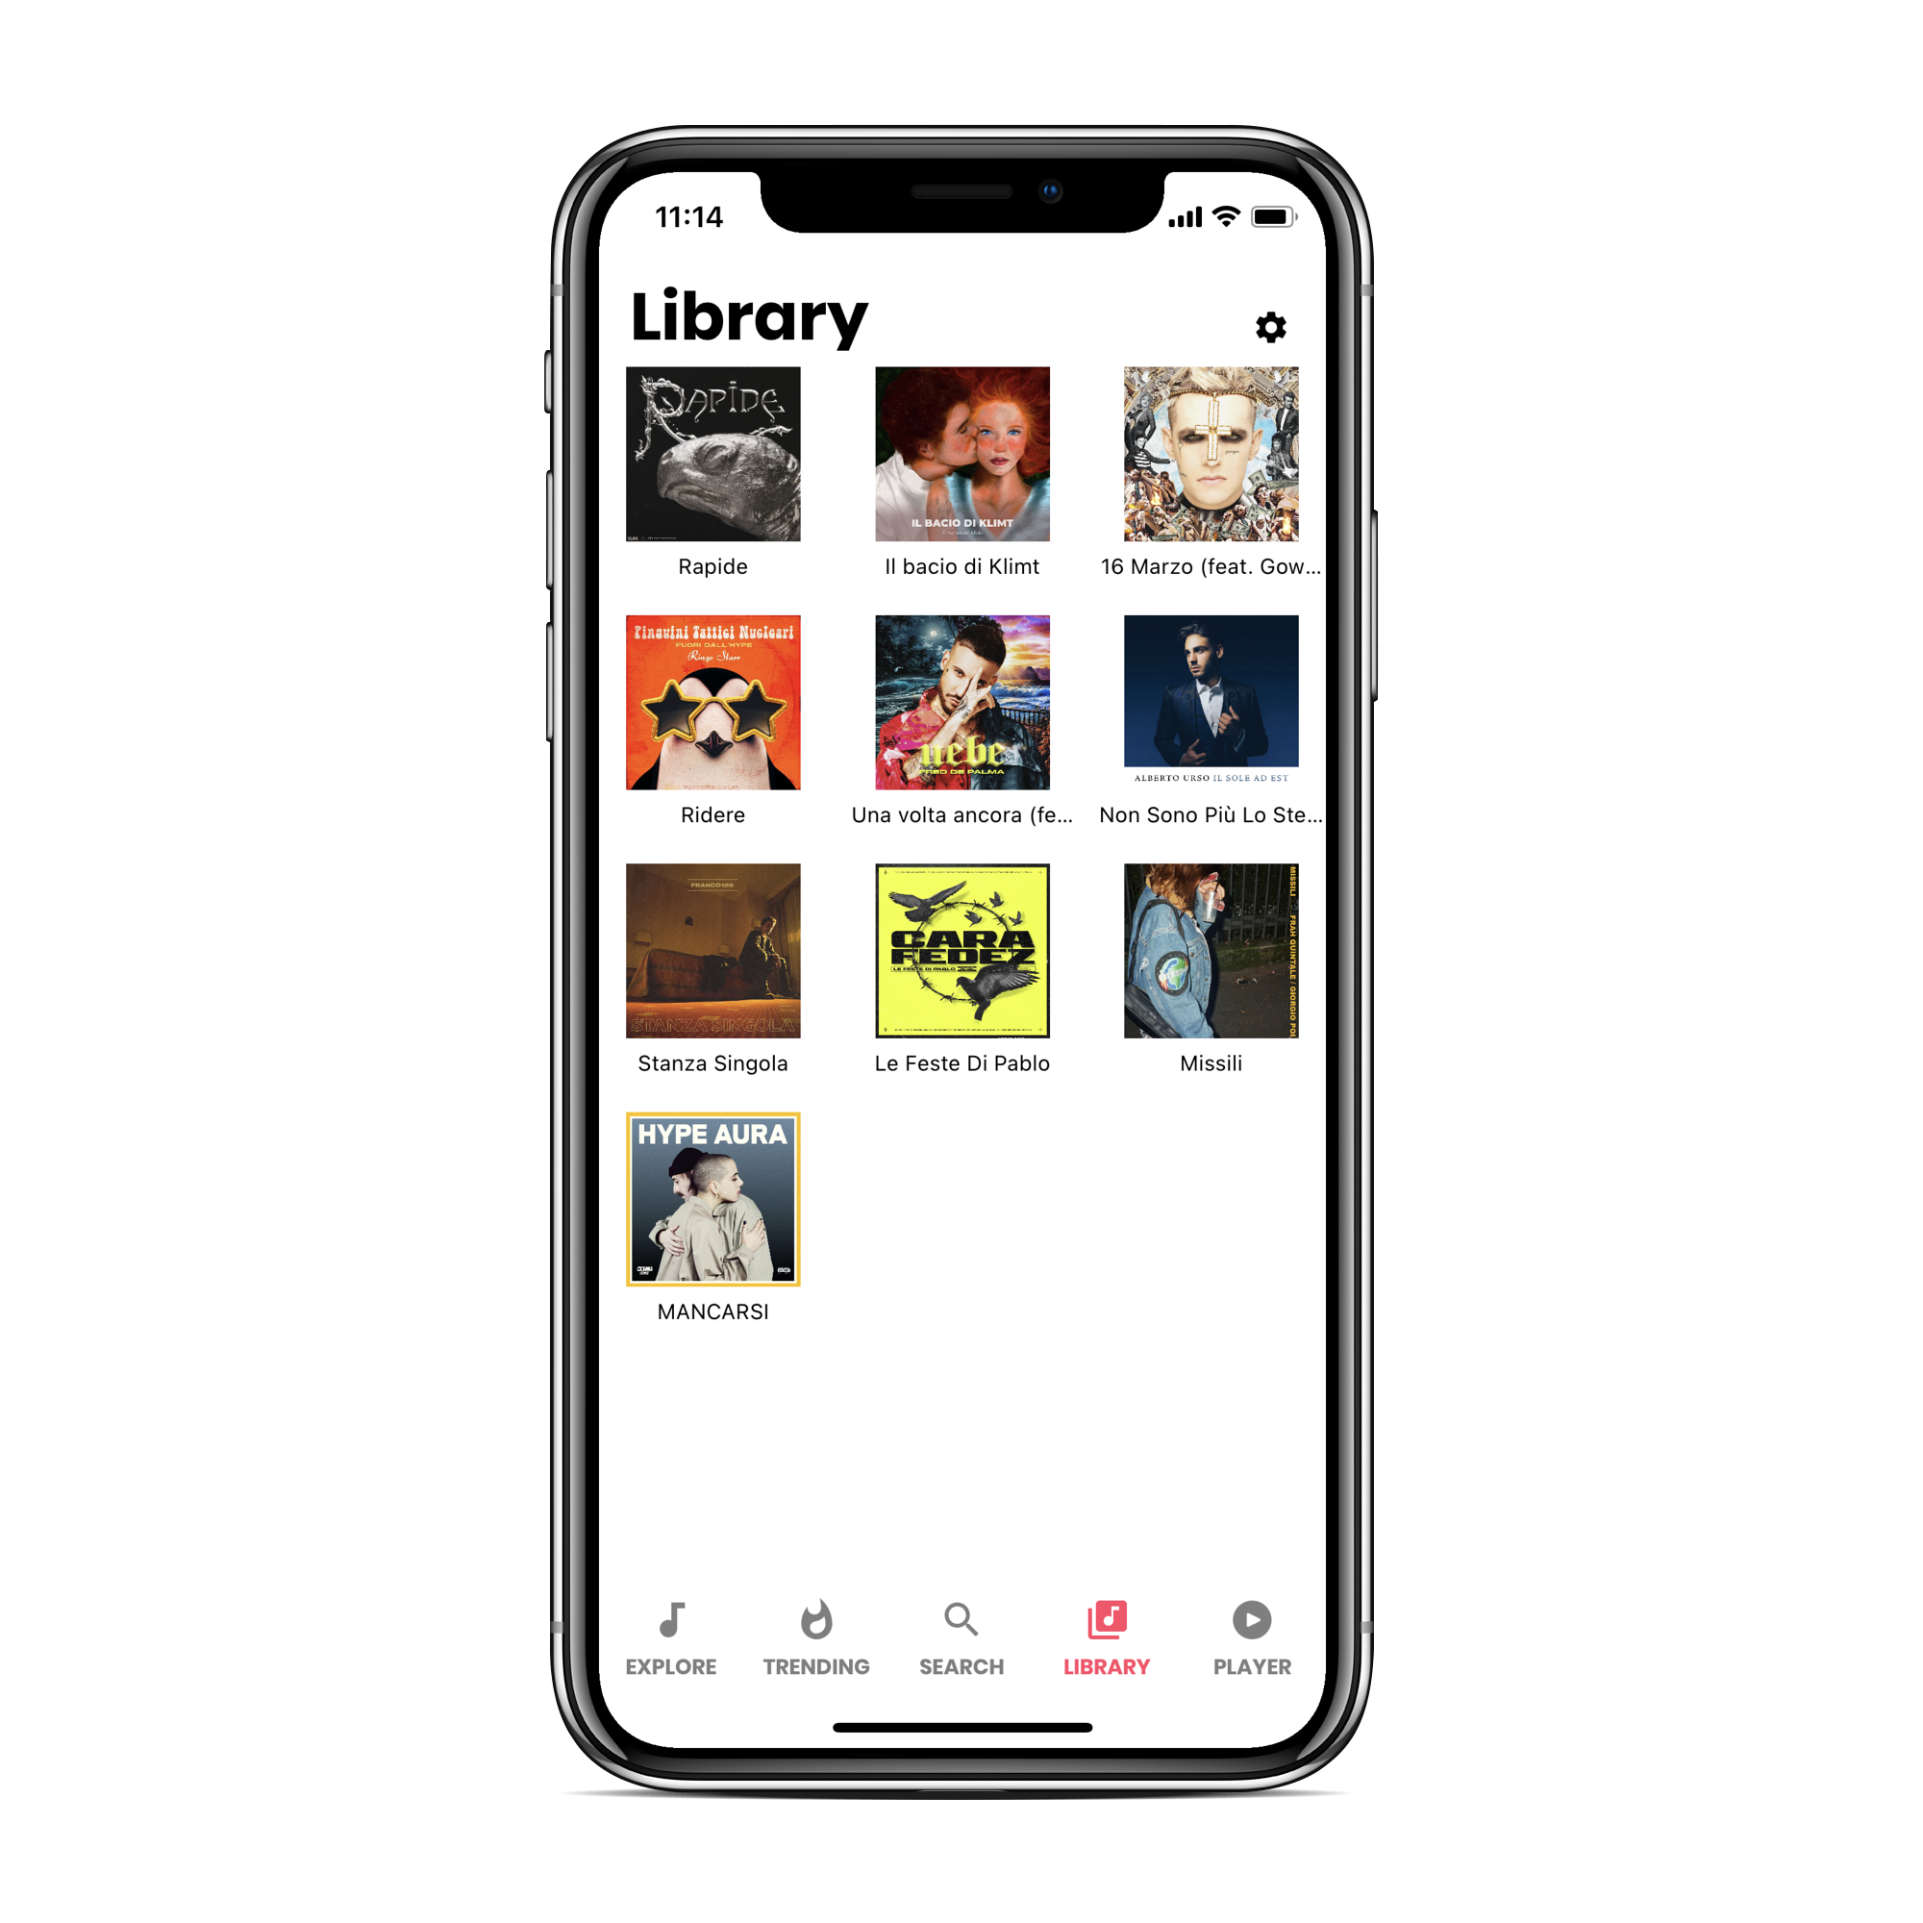
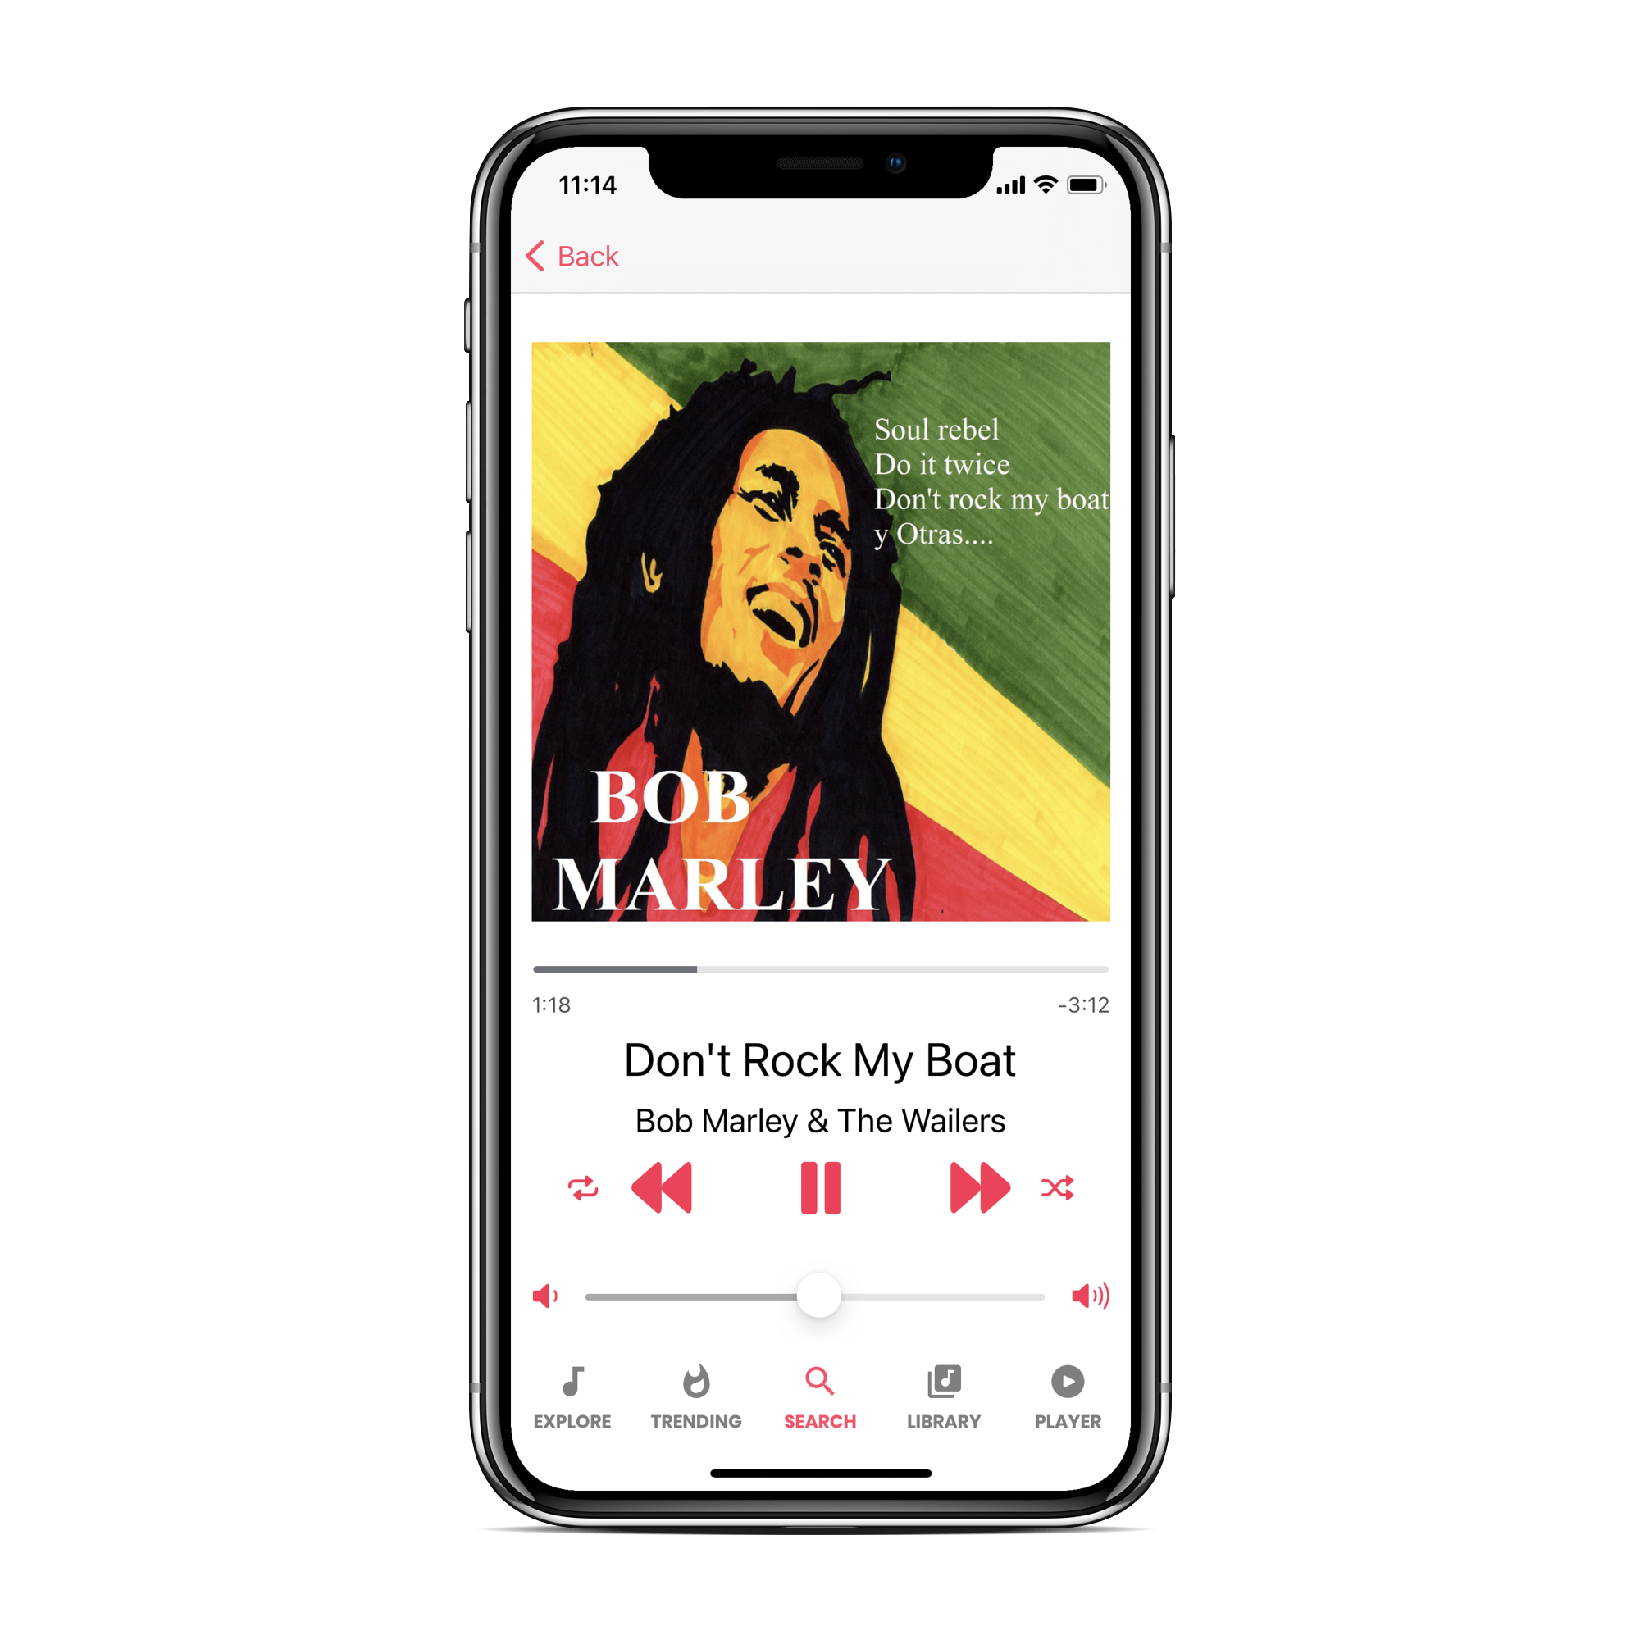
Navigation Path
Design.

Slide 15
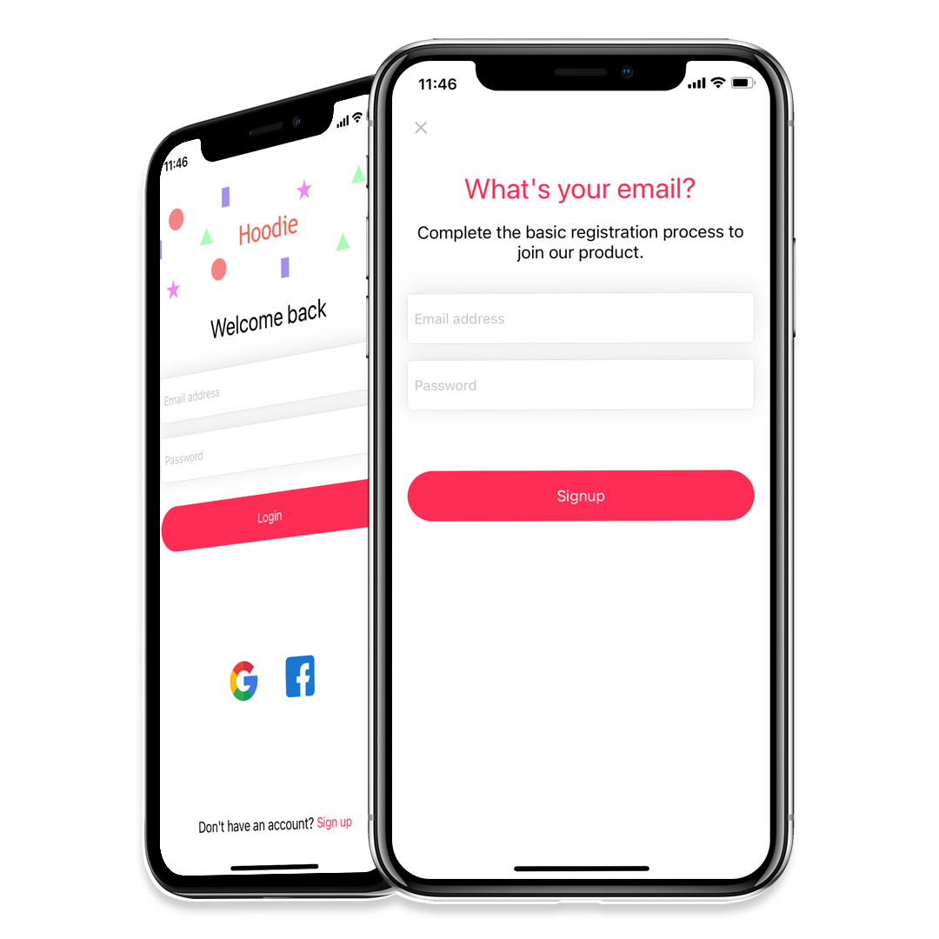
Login & Signup
Login methods supported:
Email and Password (Firebase Auth)
Google OAuth
Facebook
After login or registration, the user is redirected to the main page of the application.
Look and Feel.

Slide 16
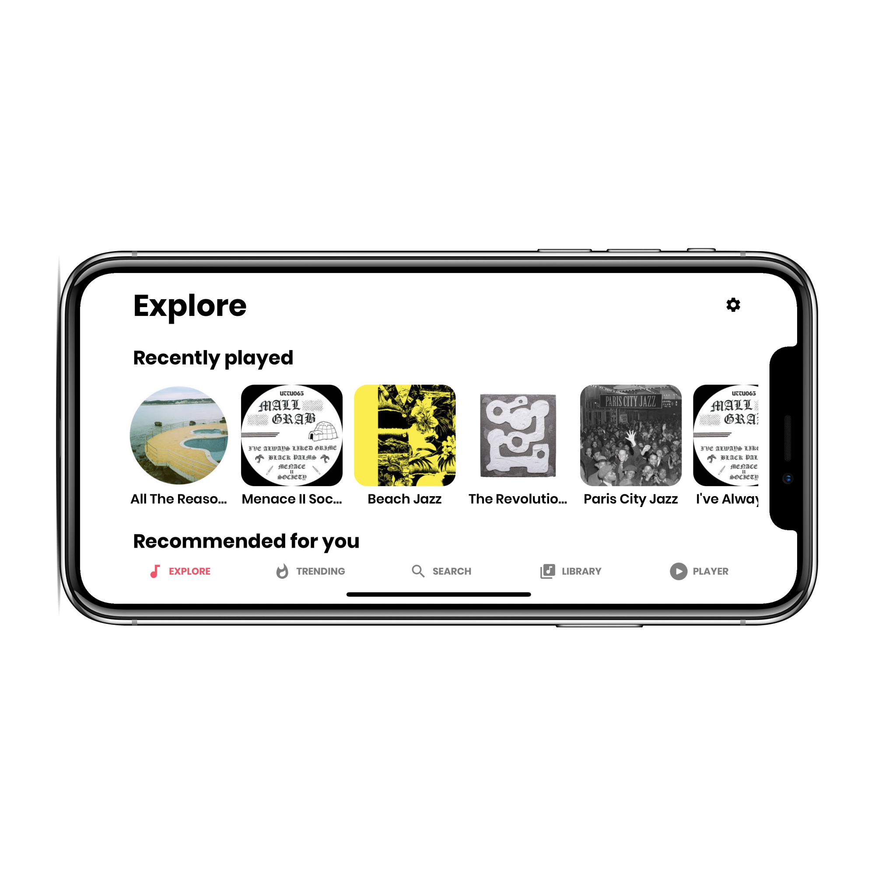
Explore View
The user can scroll through the list of songs recently listened to, those recommended for him/her based on the ratings.
It also shows a list of songs similar to the type most listened to by the user.
Look and Feel.

Slide 17
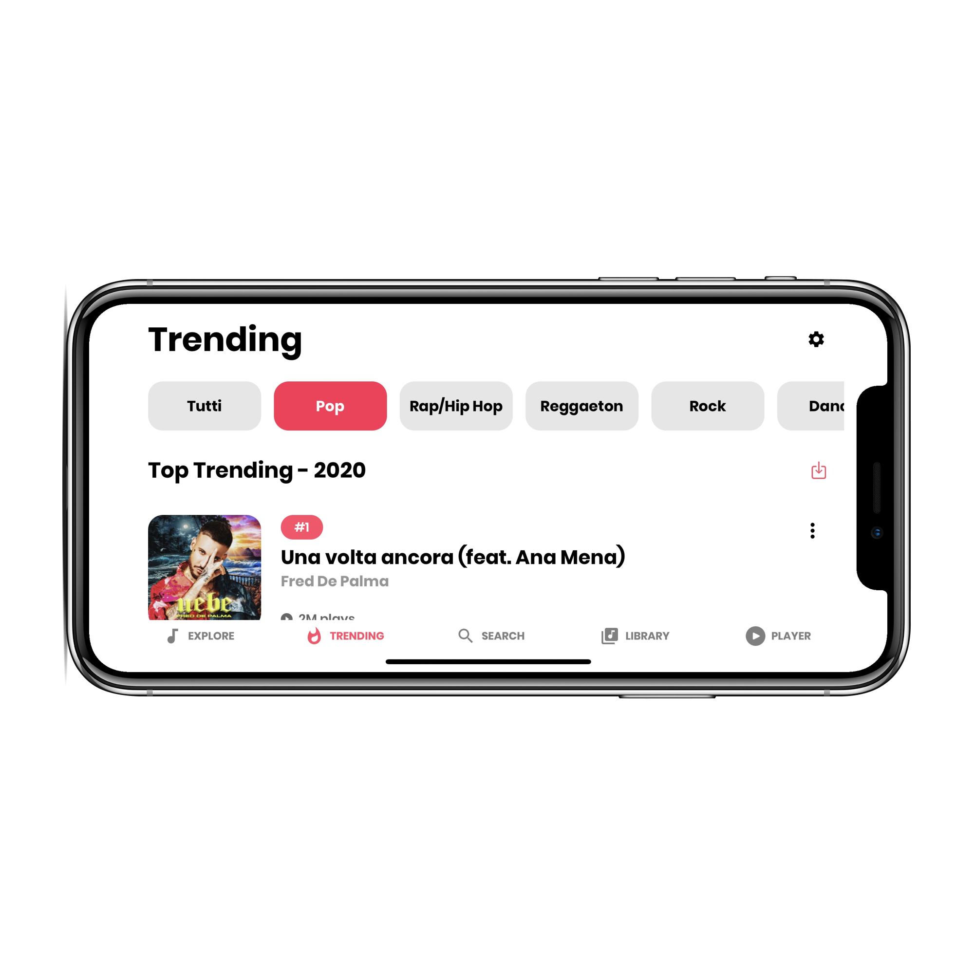
Trending View
Music trending are obtained based on certain criteria during a certain period. These include record sales, amount of radio broadcast, number of downloads, and amount of streaming activity.
In this view you can download a single song or download all top trending selected genre.
Look and Feel.

Slide 18
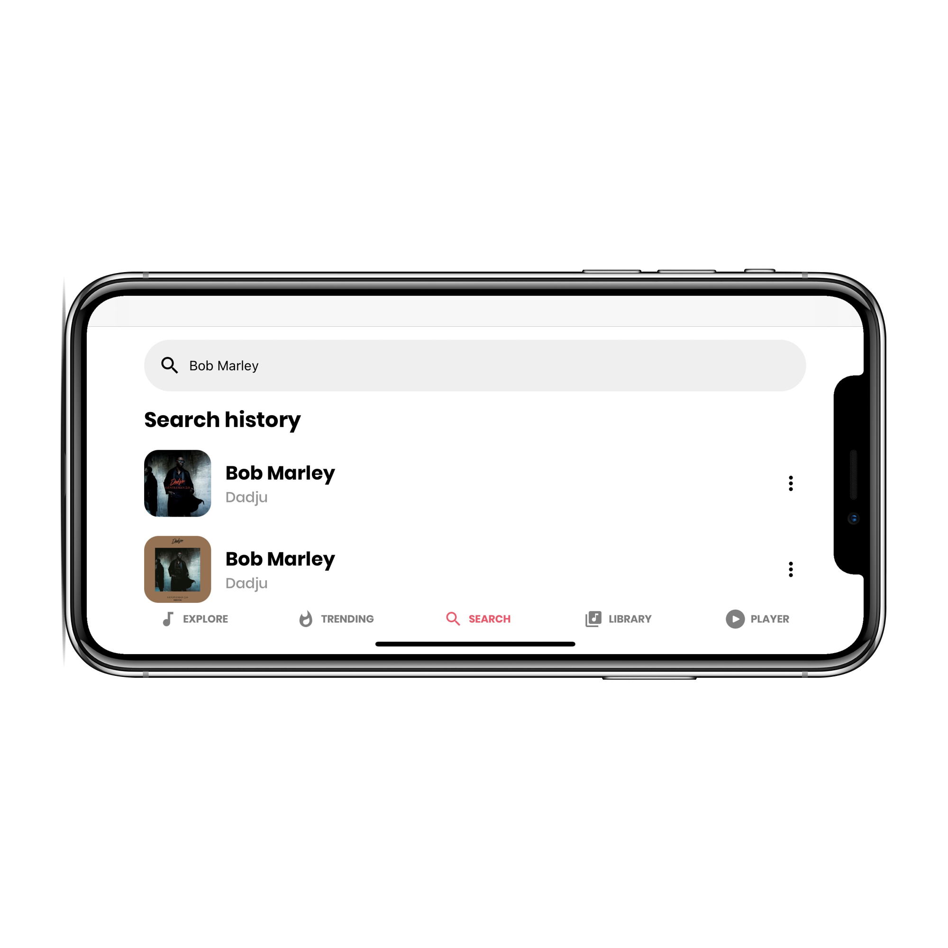
Search View
You can directly play a song by doing a search or you can download an entire album that matches that search.
The results obtained from the research are the result of the call to the Deezer API
The first result shown is the one with the highest ranking.
Look and Feel.

Slide 19
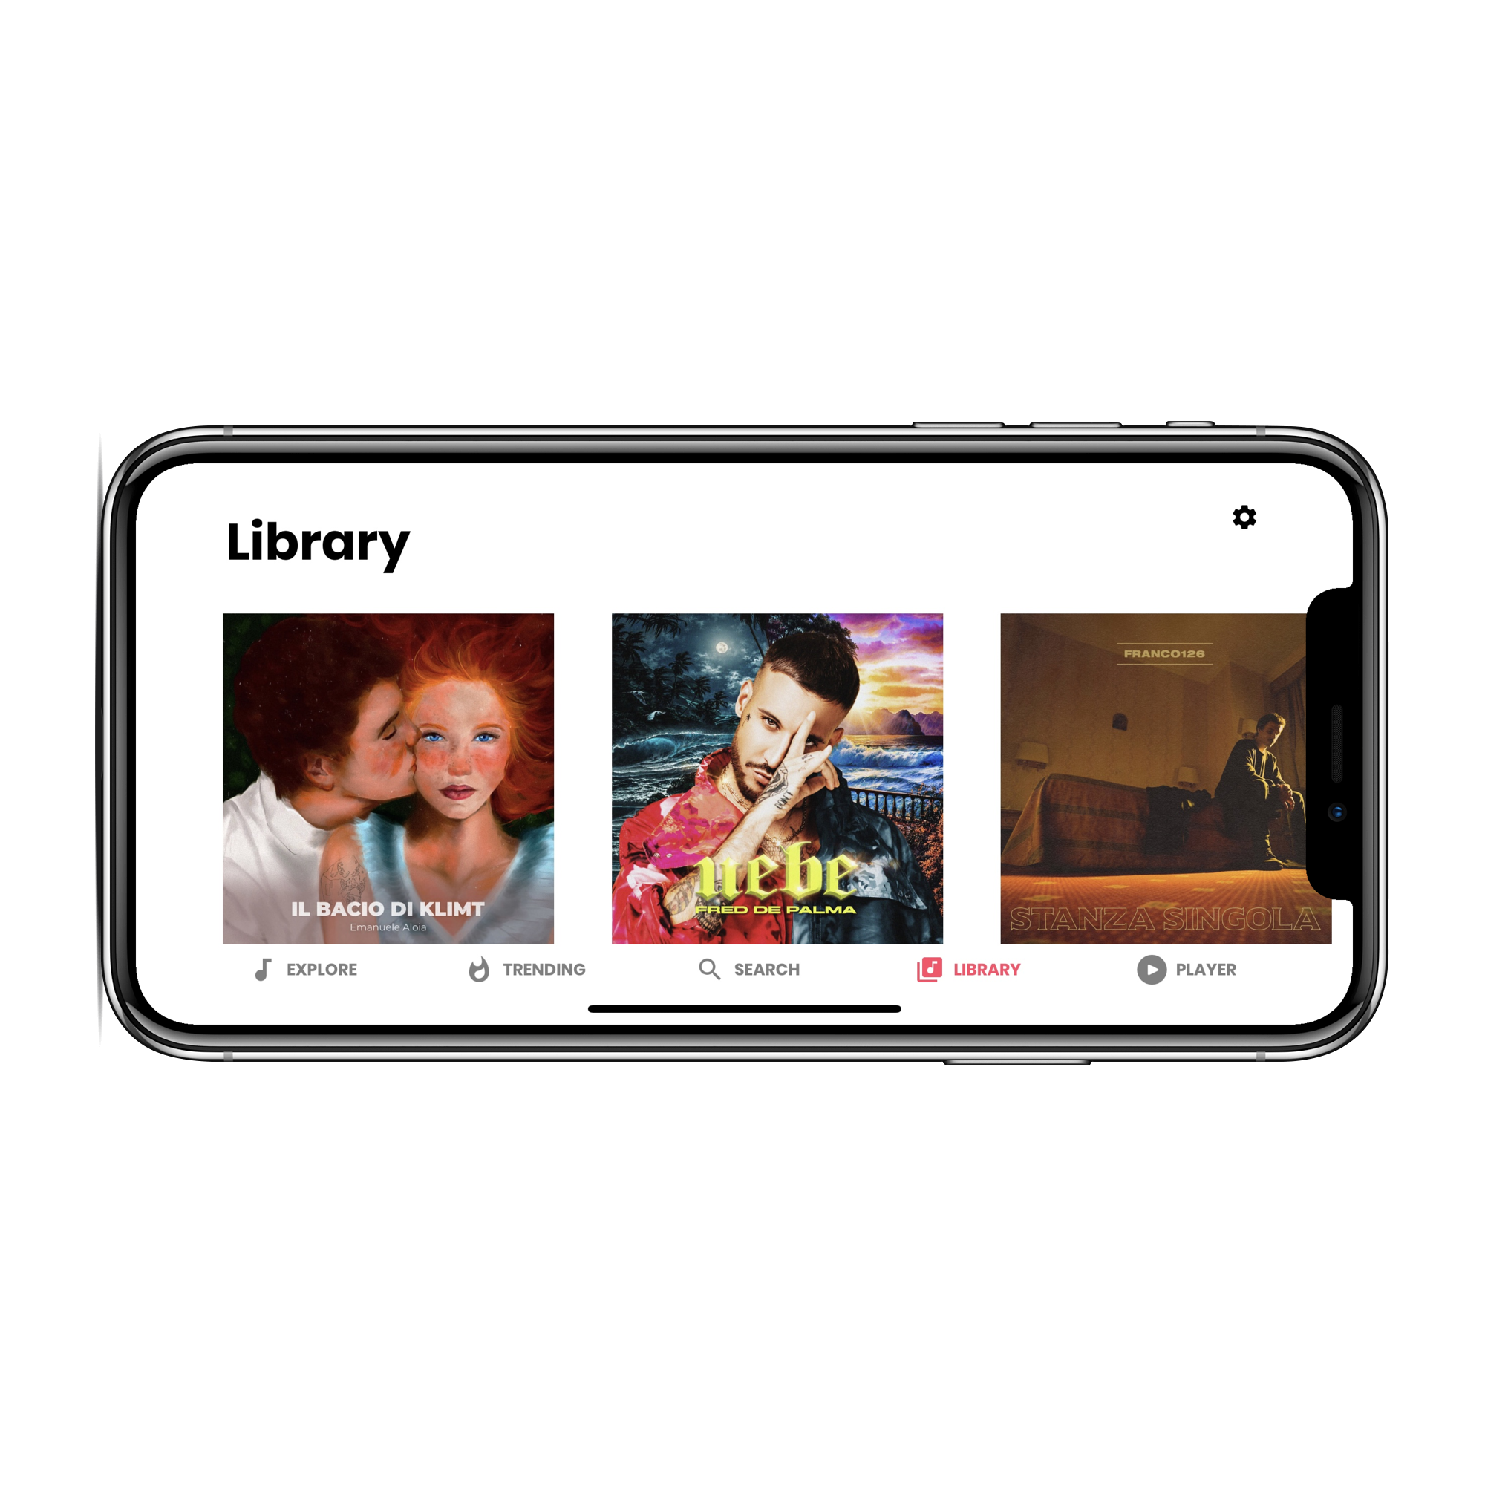
Library View
The Library view shows the songs downloaded by the user or the entire albums that the user has stored in the device.
The user can also delete the single song or select one to listen to it
Look and Feel.

Slide 20
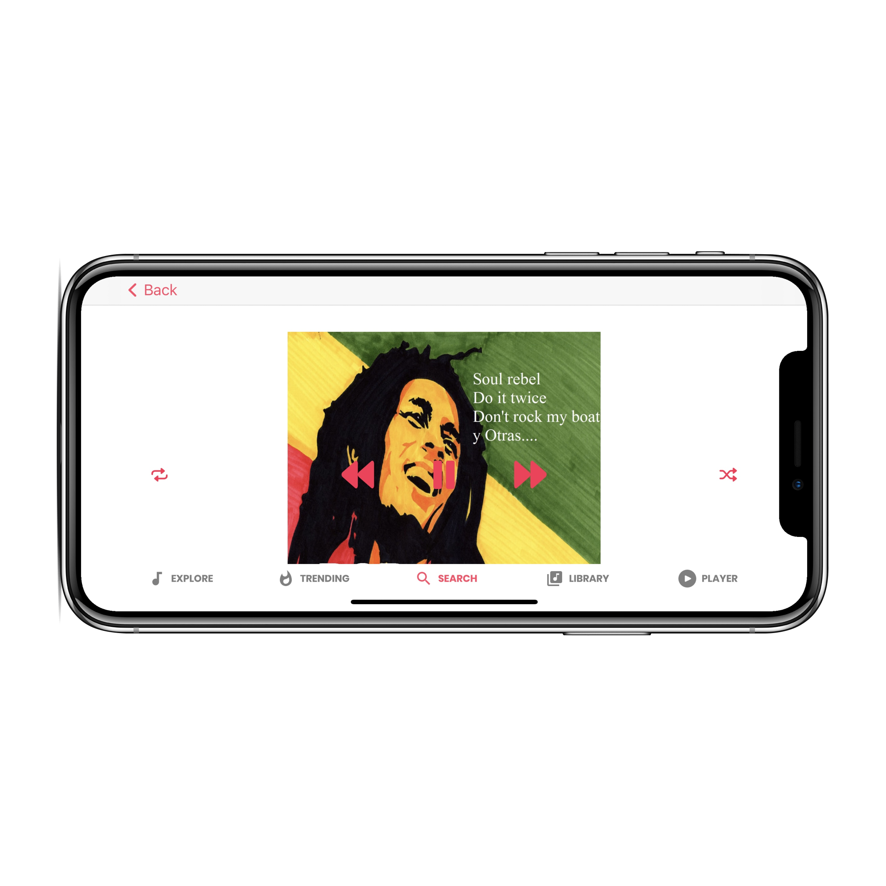
Player View
Our player shows the music currently playing
accompanying the listening showing:
- The name of the album, the song, the author
- Cover picture
- play/pause, next, previous, shuffle, repeat one, repeat all, volume slider buttons
Look and Feel.

Slide 21
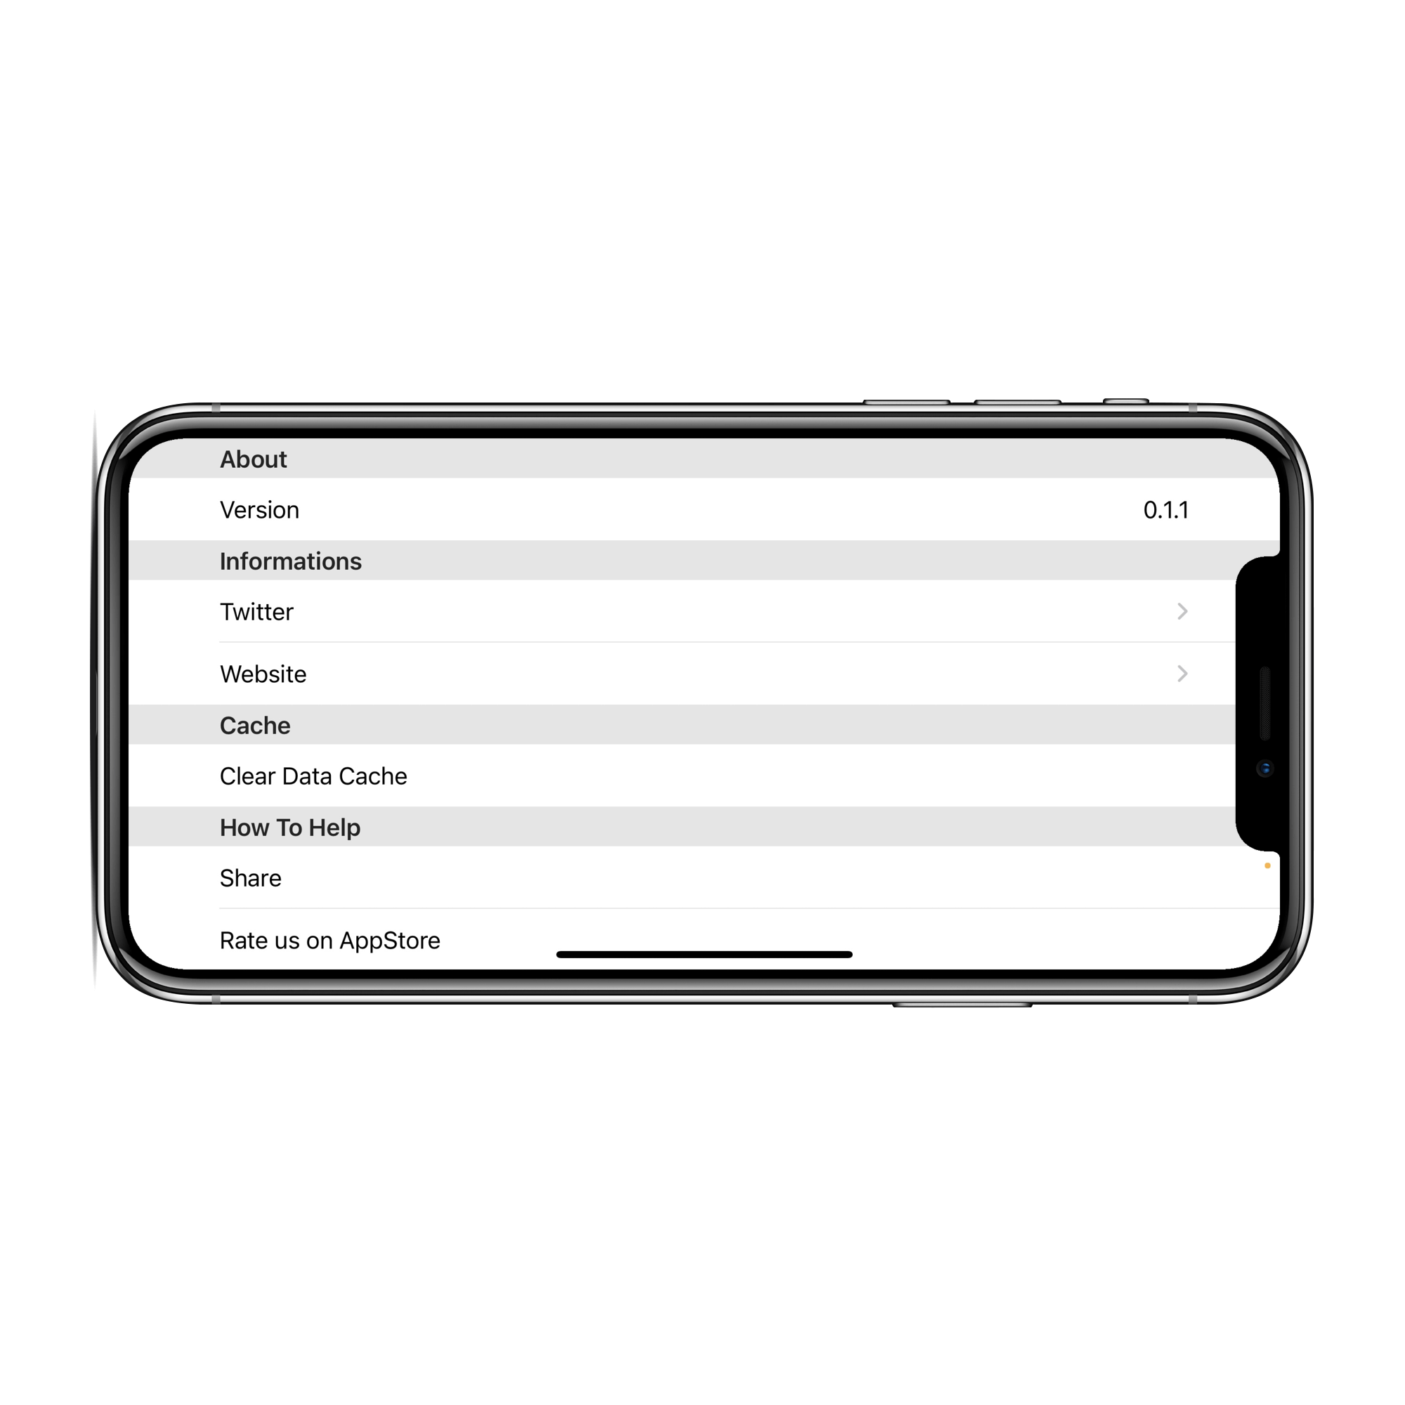
Settings View
Verify what version are you using
See app information via Twitter or Website or email
Clear Data Cache
Share our application
Rate us on AppStore
Logout
Look and Feel.

Slide 22

Requirements
What we achieved
Responsive Design.
Auth.
Service.
Multi
Thread.
External
WebAPI.
Storage
Service.
Personal Backend.
Conclusion.

Slide 23

-[
WHAT NEXT?
]-
Future Works.
A possible extension of the application is to support dynamic playlists and self-created suggestions based on the musical preferences of the individual user through the use of the data saved on the Firebase Realtime Database.
Future Work.

Slide 24

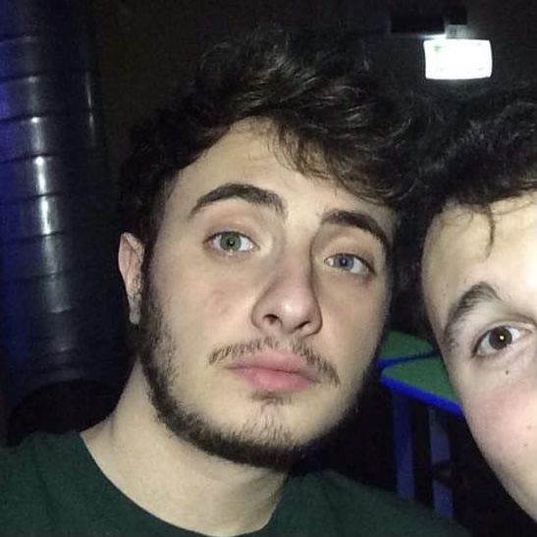



-[
For your attention
]-
Thank You

